Slide 1

DESIGN THINKING AND INNOVATION
Dr. D. Venkata Subbaiah
Professor, Computer Science & Engineering Department
Lakireddy Bali Reddy College of Engineering (A), Mylavaram

Slide 2
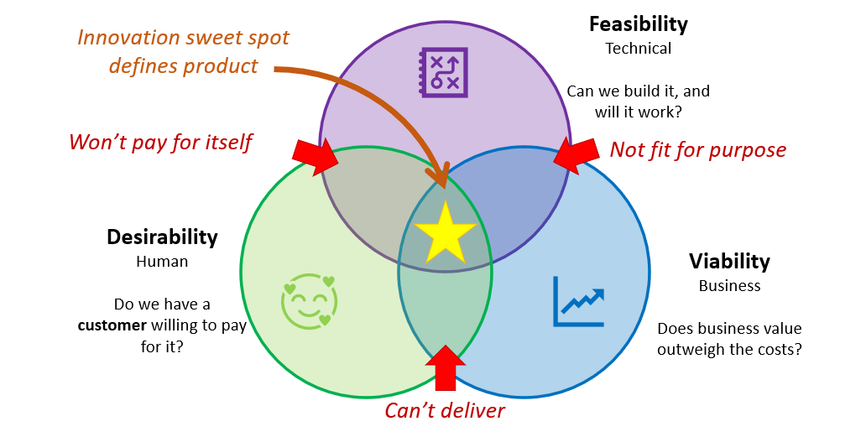
Elements of Design Thinking
Innovation/Outcome

Slide 3
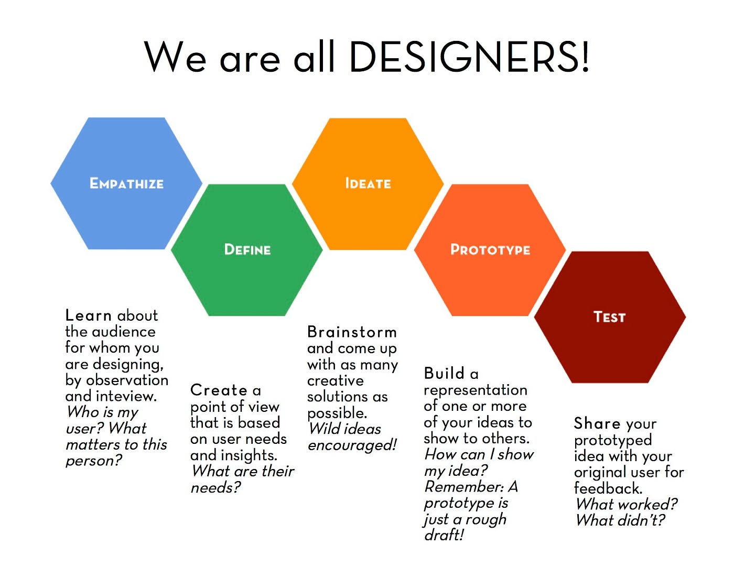
Elements of Design Thinking
INSIGHTS
NEEDS
CONCEPTS
MODELS
REFINE

Slide 4
Concept of Prototype
DEVELOPMENT OF MODELS
Prototype = the language of Design Thinking
Function = to communicate something about the idea
Purpose = to obtain feedback about the idea
A PROTOTYPE IS A MESSAGE IT COMMUNICATES SOMETHING ABOUT YOUR IDEA
A PROTOTYPE MUST SPEAK FOR ITSELF

Slide 5
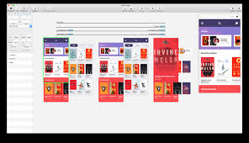
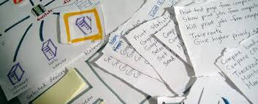
Concept of Prototype: Types
Low-Fidelity Prototype
(Rough Prototype)
High-Fidelity Prototype
(advanced interactions & transitions)
Simple Paper based Prototype

Slide 6
Concept of Prototype: Types
Low Fidelity Prototypes
Purpose: To explore and communicate basic ideas and concepts.
Appearance: Simple and minimalistic. (may be hand-drawn sketches, paper prototypes, or basic wireframes)
Functionality: Lack functional components and interactivity (do not simulate the actual functionality of the final product)
Advantage:
Quick and cost-effective to create,
Easy to make changes,
facilitate rapid ideation and exploration of design,
ideal for initial concept validation and early-stage user feedback.

Slide 7
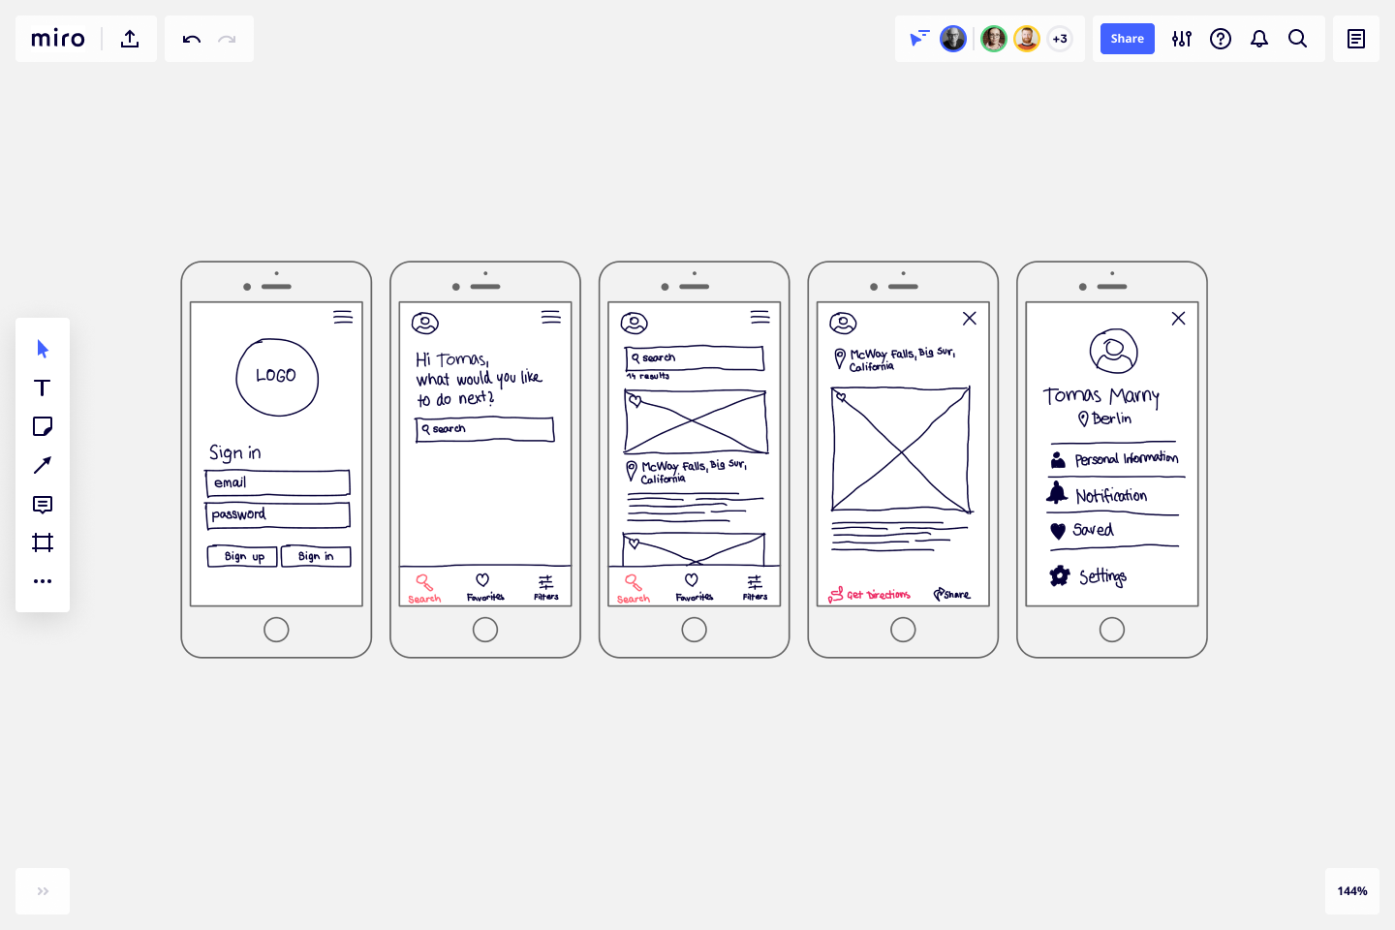
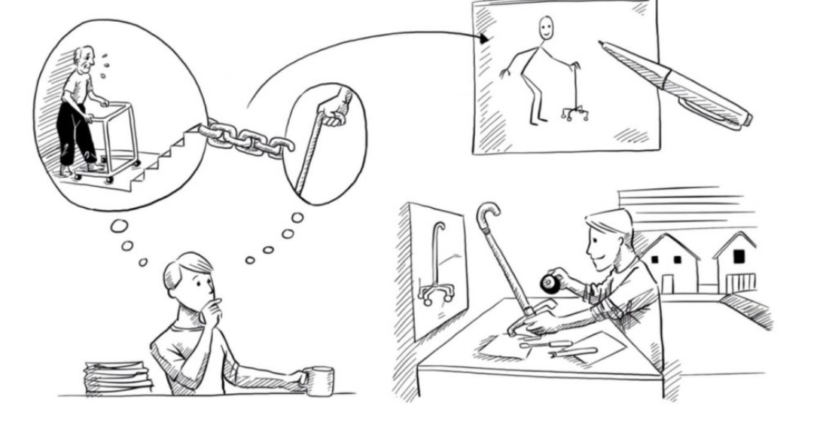
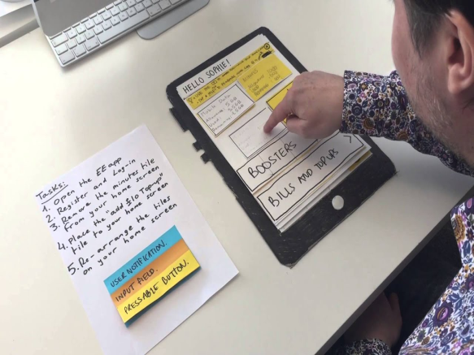
Concept of Prototype: Types
Low Fidelity Prototypes
Service-based (App/Website)
Product-based (Sketch/Rough Model)

Slide 8
Concept of Prototype: Types
High Fidelity Prototypes
Purpose: More detailed and realistic representations of the final product (Stimulate actual user experience, test the functionality)
Appearance: Closely resemble the final product in terms of visual design and interaction
Functionality: Include interactive elements, mimic the functionality of the final product (user can interact with different features including screen, allow more accurately usability testing)
Advantages:
Provide realistic user experience
useful to attract the stakeholders and investors
Can help to identify and address usability issues.

Slide 9
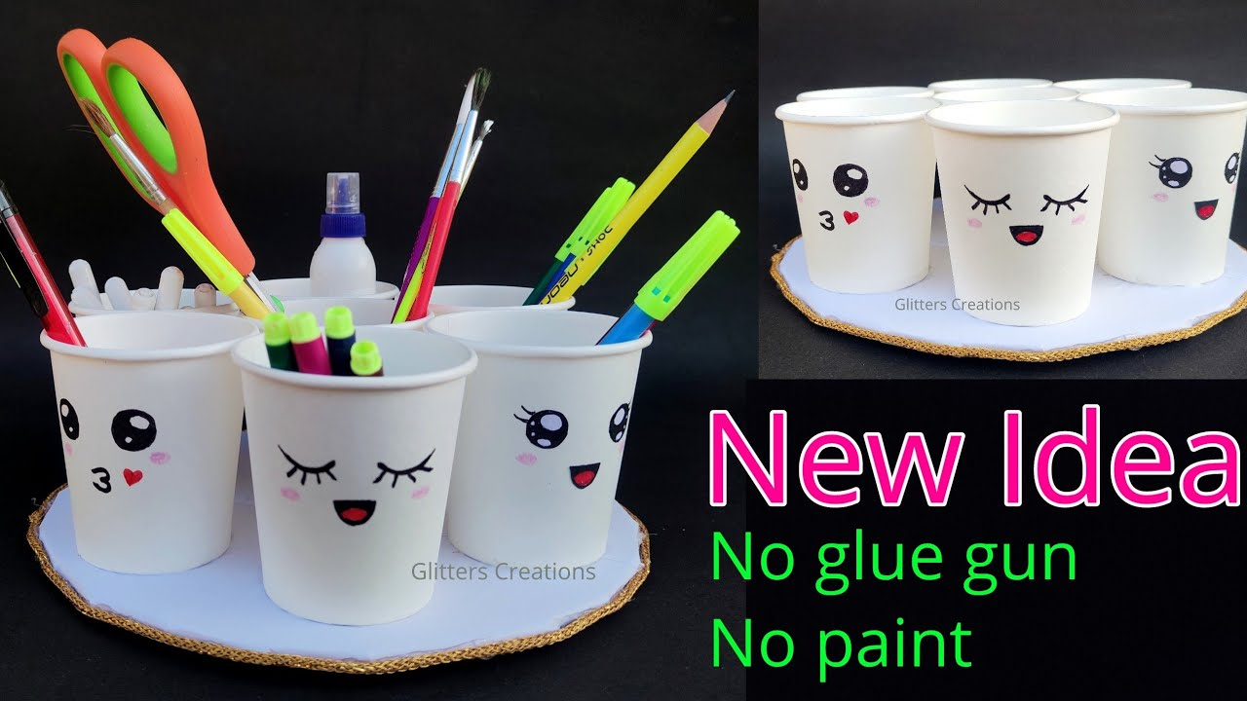
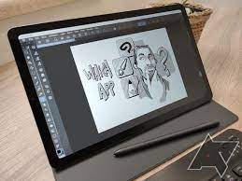
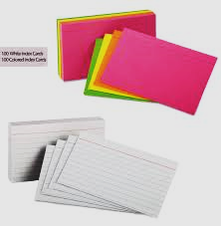
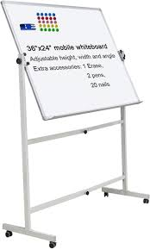
Concept of Prototype: Types
Low Fidelity Prototypes : Tools to be used
Pen and Paper
Whiteboard
Sketching Apps or Software
Cardboard or Foam Board
Storyboard
Index Cards

Slide 10
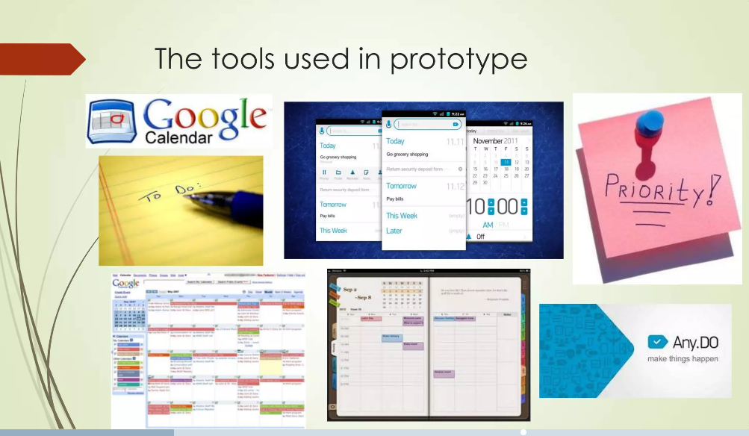
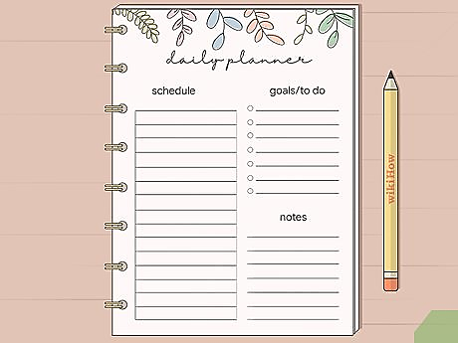
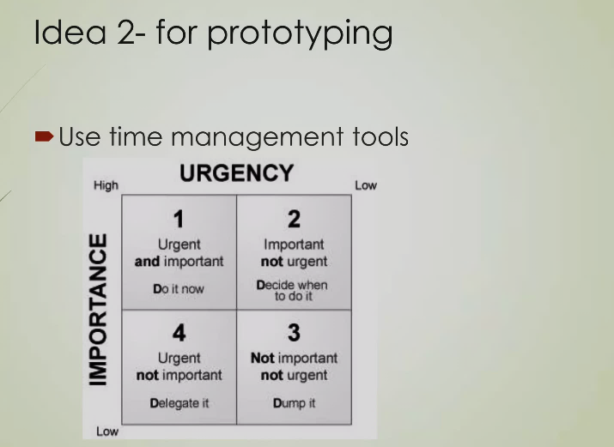
Concept of Prototype: Types
Low Fidelity Prototypes : Example
Design a Rough Prototype for a smart, intelligent, hard-working student at a reputed B-school needs a way to manage time between studies and work.
Solution: Google Calander or Physical Diary

Slide 11
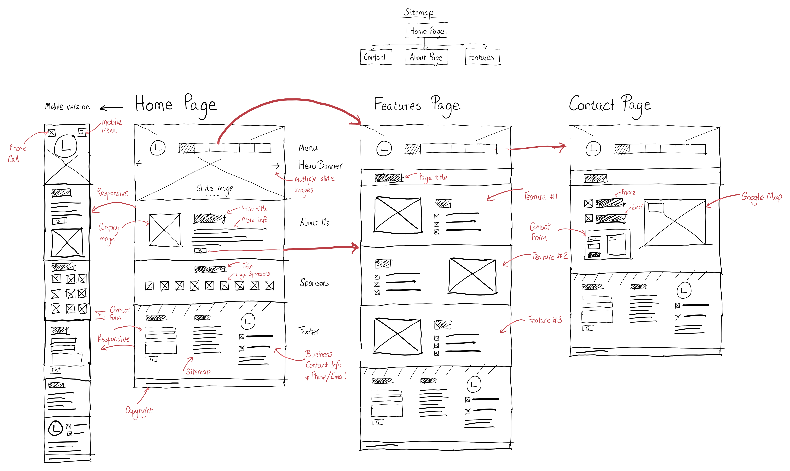
Concept of Prototype: Types
Low Fidelity Prototypes:
Example
Design of features in a website or app for an user
Sign-in/up Page
Home Page
Features Page
Contact Page

Slide 12
Concept of Prototype: Types
Low Fidelity Prototypes: Example activity
Design any of the prototypes for an user – Either Mobile app or Web app- with all the features and step-by-step activities/screens
E-commerce App/website
Health/Fitness Tracking App/website
Travel booking App/website
Food delivery App/website
Task Management App/website
E-learning App/website
Should include
Sign-in/up Page
Home Page
Features Page
Contact Page
Your PROTOTYPE MUST EXPLAIN ITSELF
Your PROTOTYPE Should Communicate One Or More Benefits/Features

Slide 13
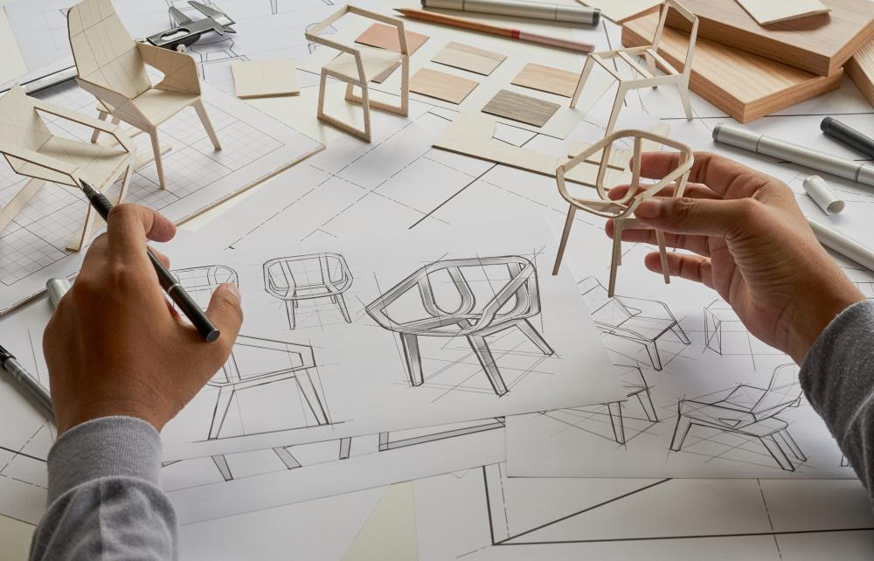
Concept of Prototype: Types
Low Fidelity Prototypes: Example activity
Simple physical prototypes for an user

Slide 14
Concept of Prototype: Types
Low Fidelity Prototypes: Example activity
CREATE A ROUGH PROTOTYPE in the form of an original illustration with written explanations.
Remember:
Your PROTOTYPE MUST EXPLAIN ITSELF
Use your PROTOTYPE should communicate one or more benefits/features.
Choose anyone to Rough Sketch and Paper PROTOTYPE
Gadgets for polling
Electrical car design
User-friendly remote control for a TV
User-friendly Multi-purpose Wallet
.. Many more … any other

Slide 15


